Slide 1
MSW EXAMPLE
BY: DANIEL DE PAZ

Slide 2
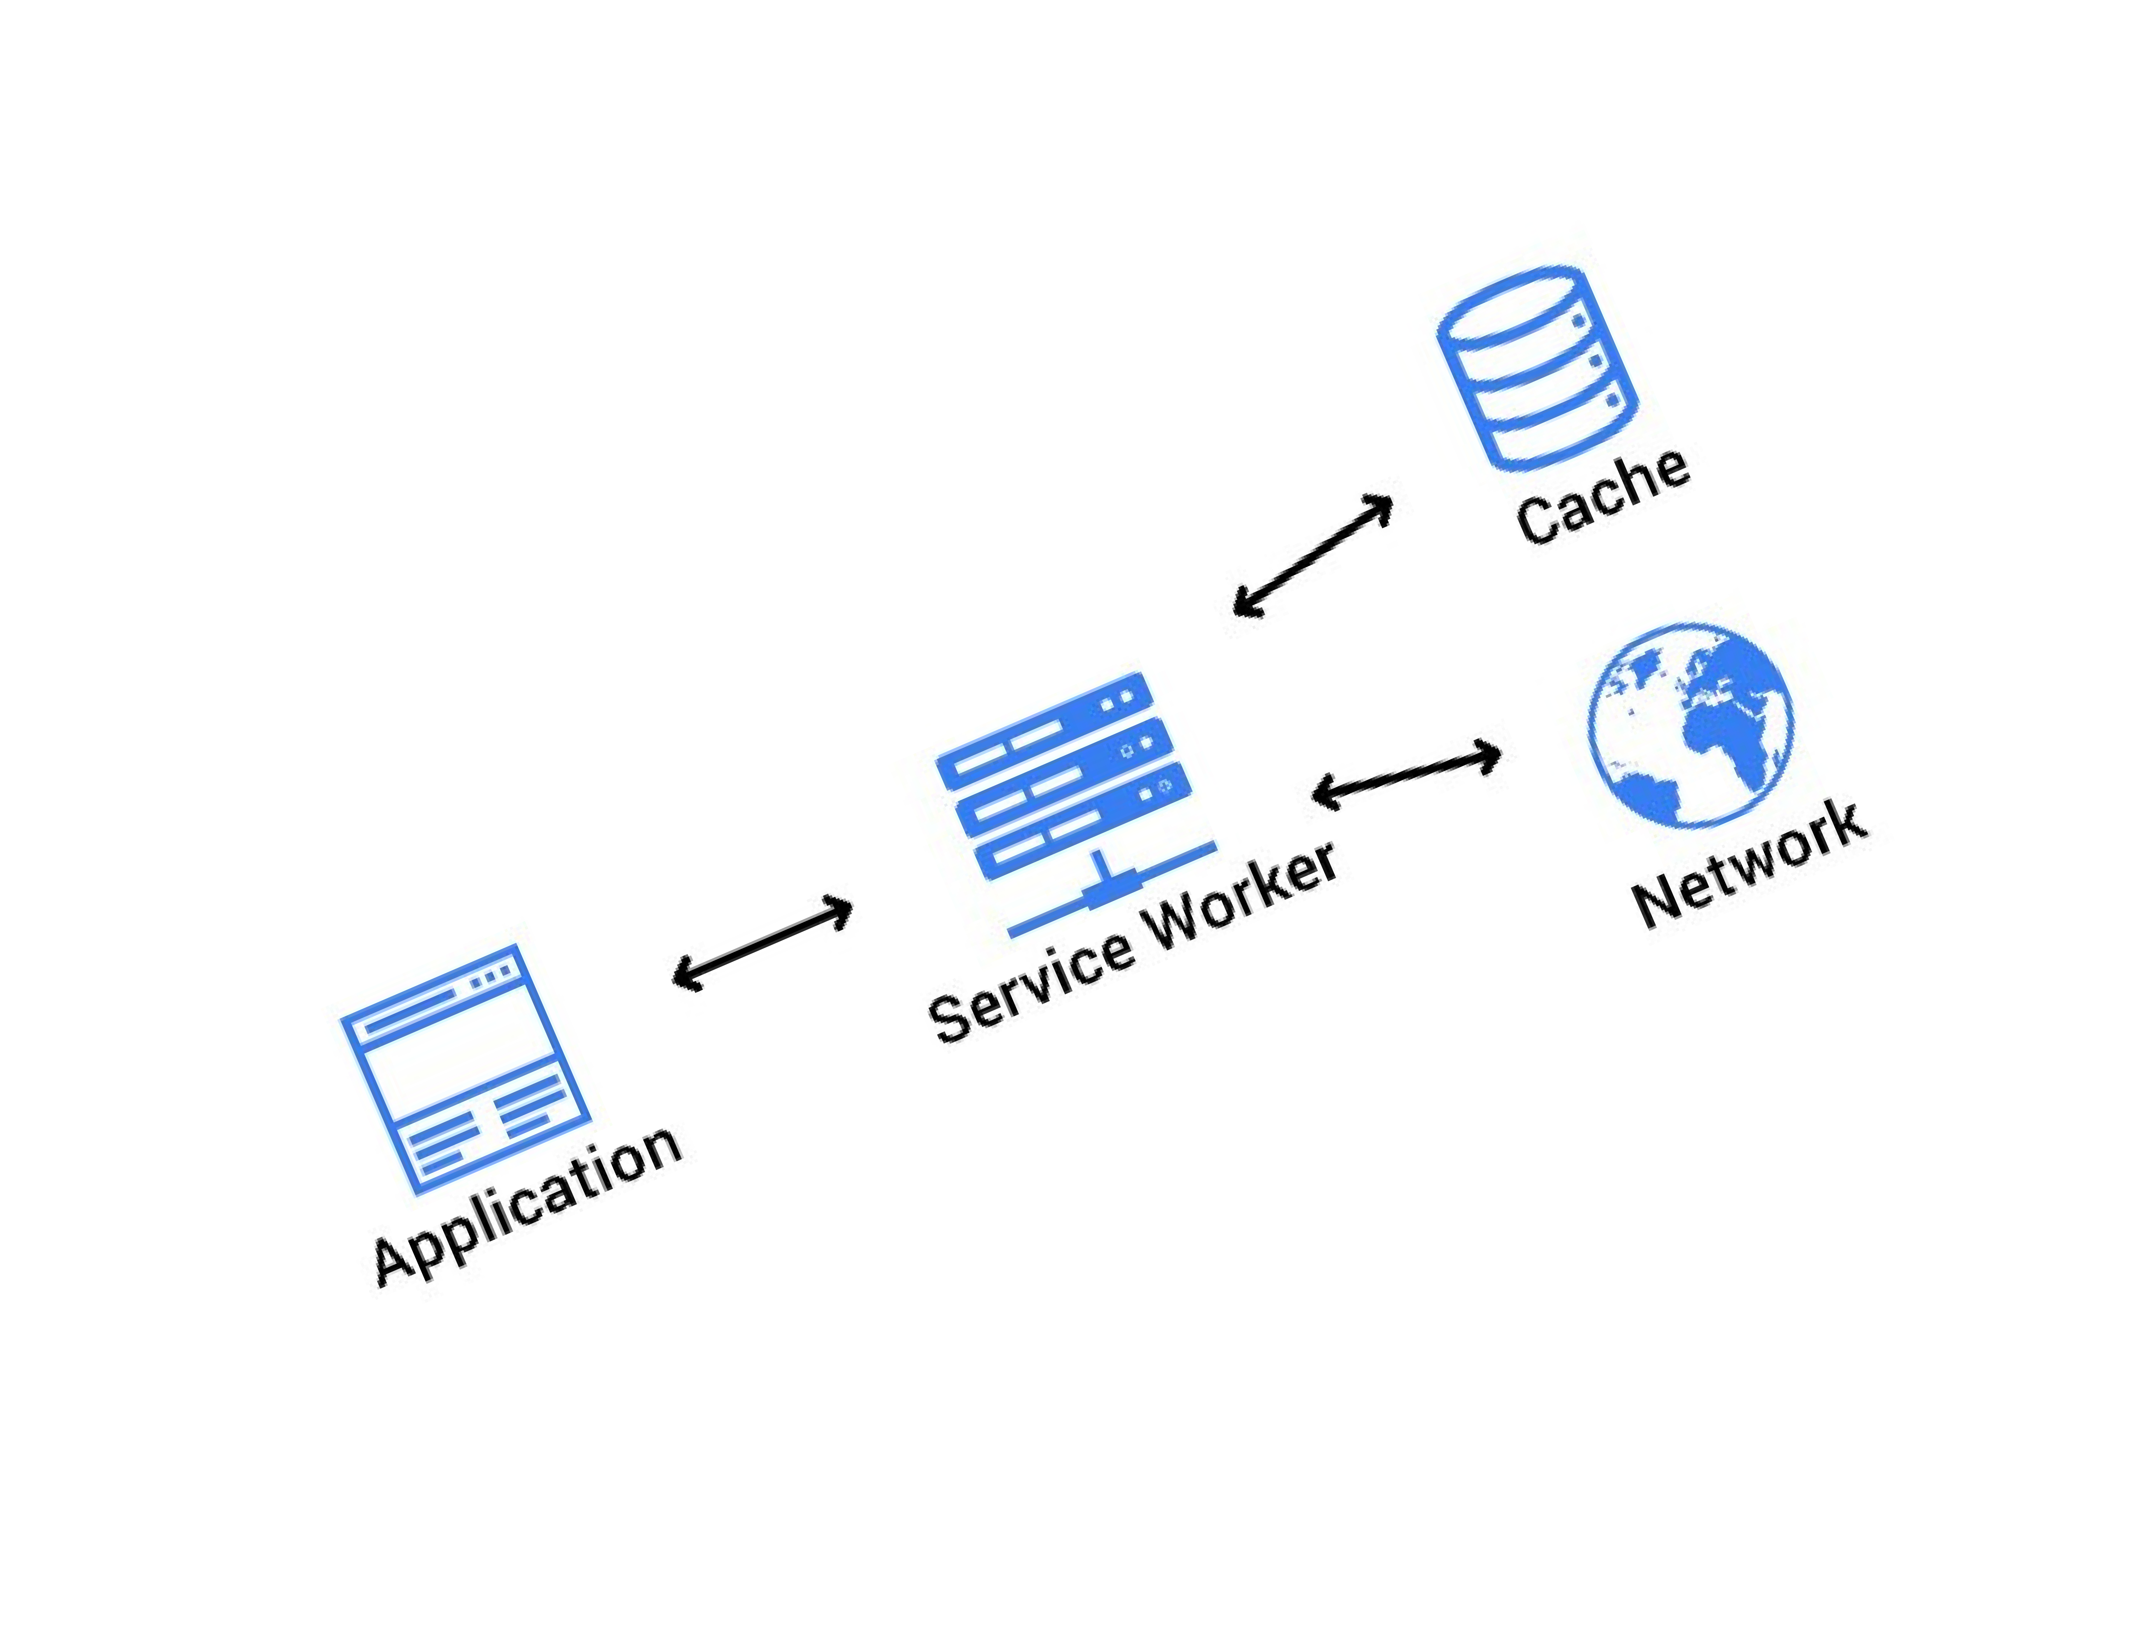
What is a service worker?
It's essentially a JavaScript file that runs separately from the main browser thread, intercepting network requests, caching or retrieving resources from the cache, and delivering push messages.

Slide 3
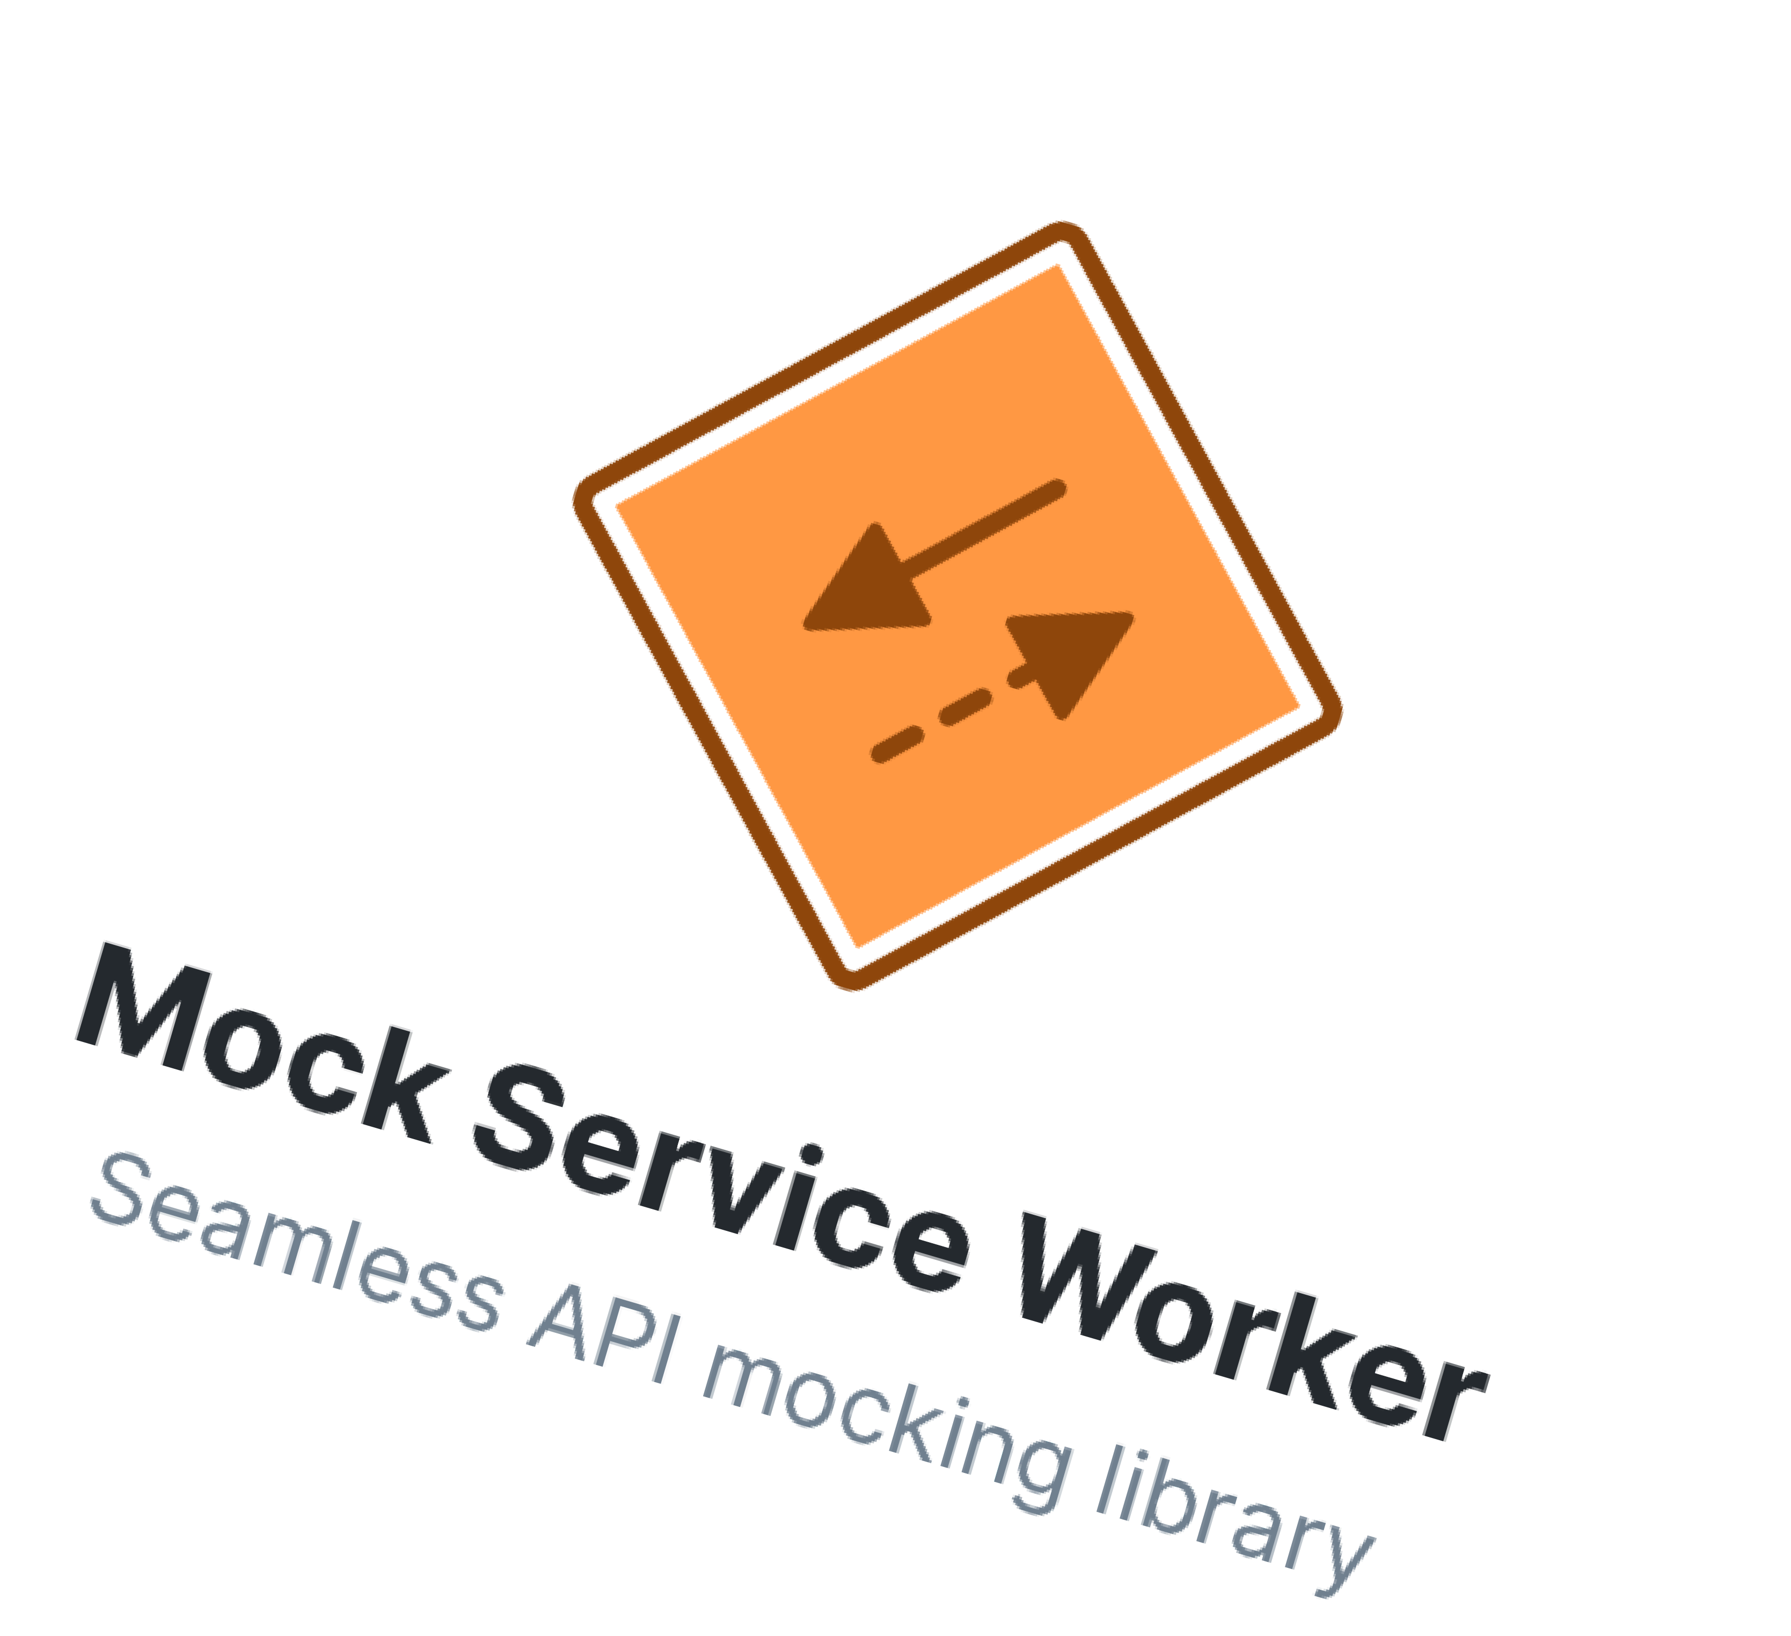
What is MSW?
Is an API mocking library that uses Service Worker API to intercept actual requests.

Slide 4

Why mock an API?
To have standard responses
Not rely on the backend

Slide 5
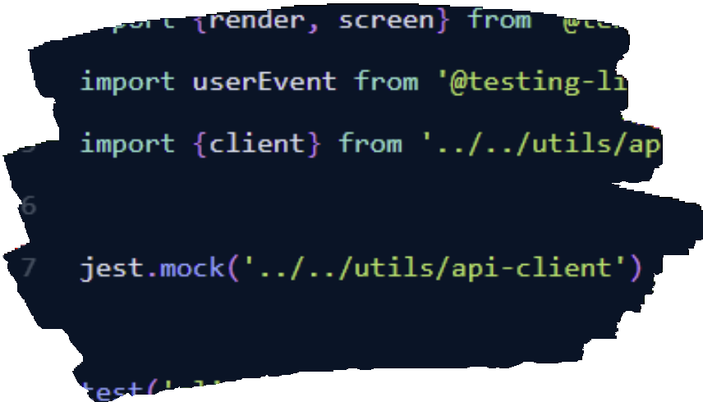
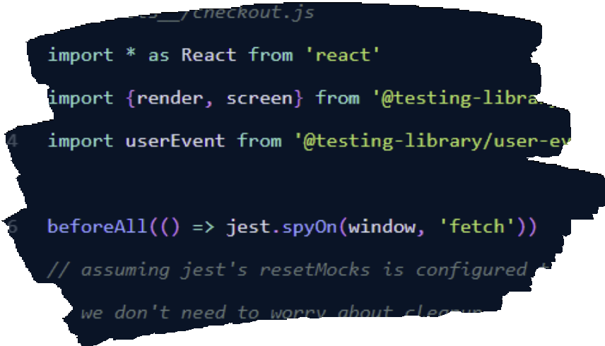
Different ways to do it
Mock out the client
We mock out window.fetch
Create a mock server that intercepts all requests and handle it

Slide 6
MSW vs MirageJS
Service worker vs replace native XMLHttpRequest and Fetch

Slide 7
EXAMPLE

Slide 8
Thank you!
Questions? @DanielDePaz on slack

